Slide 1

FInal Project - High Altitude Balloon Payload
Luciano Henriquez
03/13/2025
University of Denver

Slide 2
Design Objectives
We wish to design a payload capable of taking measurements at high altitudes. The payload has a microprocessor equipped with a shield that:
Functions in extreme conditions
Is cost-effective
Uses easily-available parts

Slide 3
Design Objectives
Further, the microprocessor and shield must be capable of the following:
Measuring both internal and external temperature
Measuring pressure
Measuring humidity
Writing data to storage medium (sd card)
Measure acceleration
Is battery operated

Slide 4
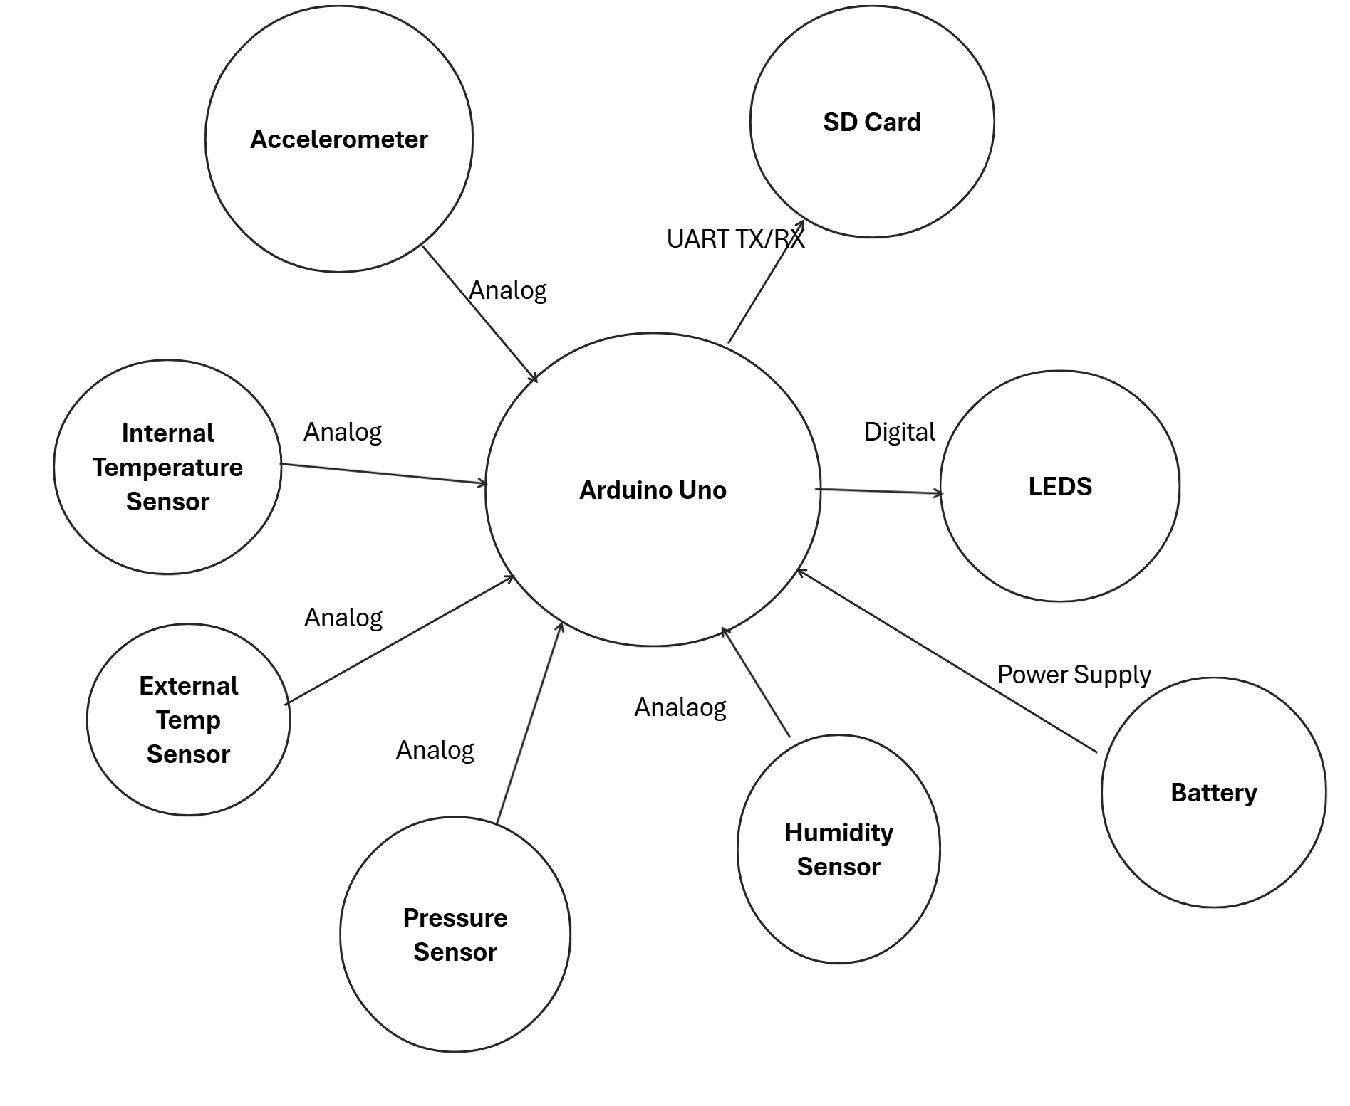
Current Block Diagram

Slide 5
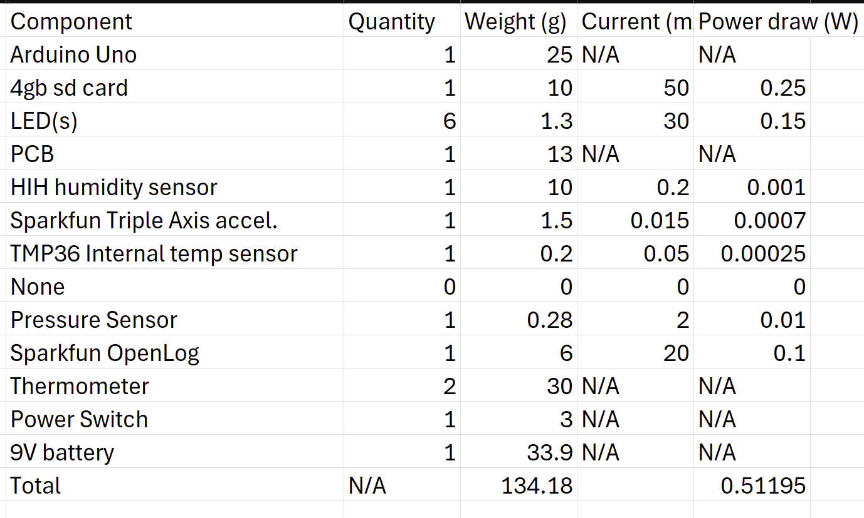
Current Specs

Slide 6
Current Design- Flaws
The current design of the PCB shield has several drawbacks that may encumber a student’s ability to launch the payload:
Several components are unavailable, including the humidity sensor.
The shield relies heavily on components that use analog pins to communicate with the microprocessor

Slide 7
Aside on analog pins
Distance - with so many components relying on the Arduino analog pins, it is likely that a few of them will be placed far from the arduino analog pins
Error susceptibility - Analog pins read voltage levels, which are highly susceptible to environmental noise. In high altitude, electrical interference is more likely due to the presence of high energy radiation
Convenience - You need an ADC

Slide 8
Considerations
Want to use I2C or SPI for reasons outlined in preceding slide
For multiple devices, it is convenient to use I2C - due to its shared bus architecture with unique addresses (so long as we don’t use too many of the exact same IC)
Our humidity sensor needs to operate in extreme conditions, we are looking for a humidity sensor that is able to take measurements in all RH ranges.
Our external temperature sensor must withstand < -50 °C temperatures (this is not very common)

Slide 9
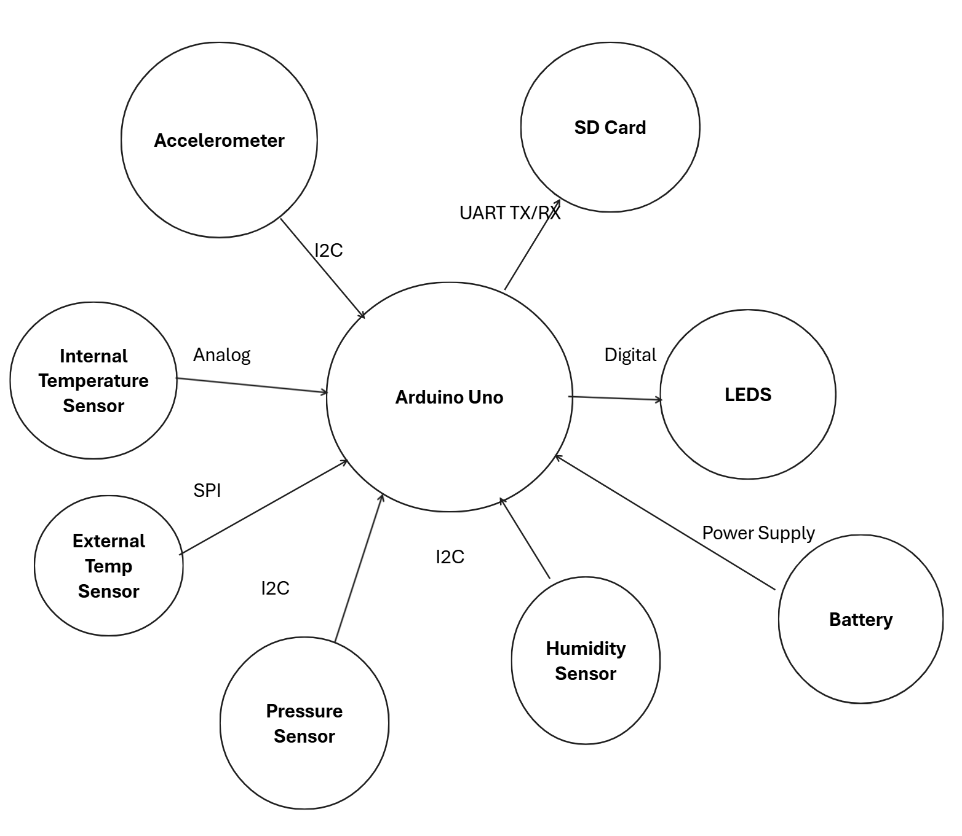
New Block Diagram

Slide 10
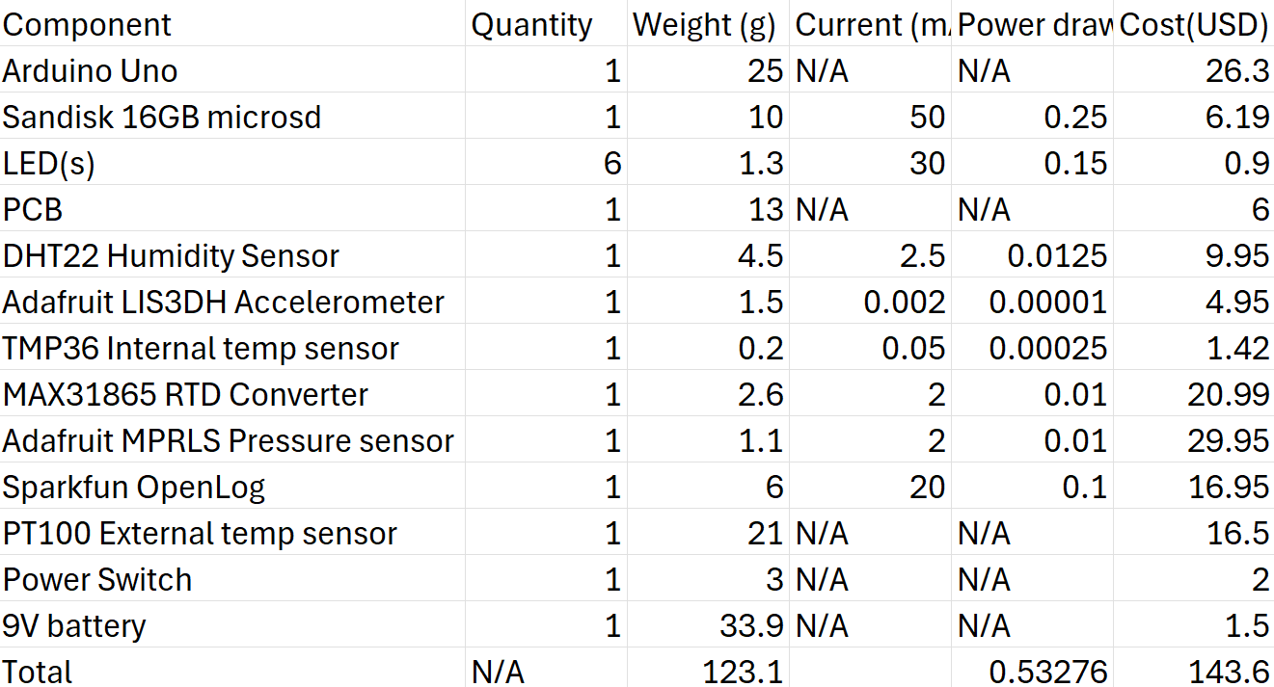
Components

Slide 11
Improvements
MAX31865 and PT100 RTD sensors. More expensive, but more accurate and work at temperatures as cold as -200°C. Uses SPI protocol, better than using analog pins.
Adafruit MPRLS sensor for pressure, expensive but well worth it, highly reliable, good accuracy, and works well in extreme environments
Most sensors using I2C protocol, which is better in high radiation environments
Significantly less power draw, as accelerometer and internal temp sensors draw very little current

Slide 12
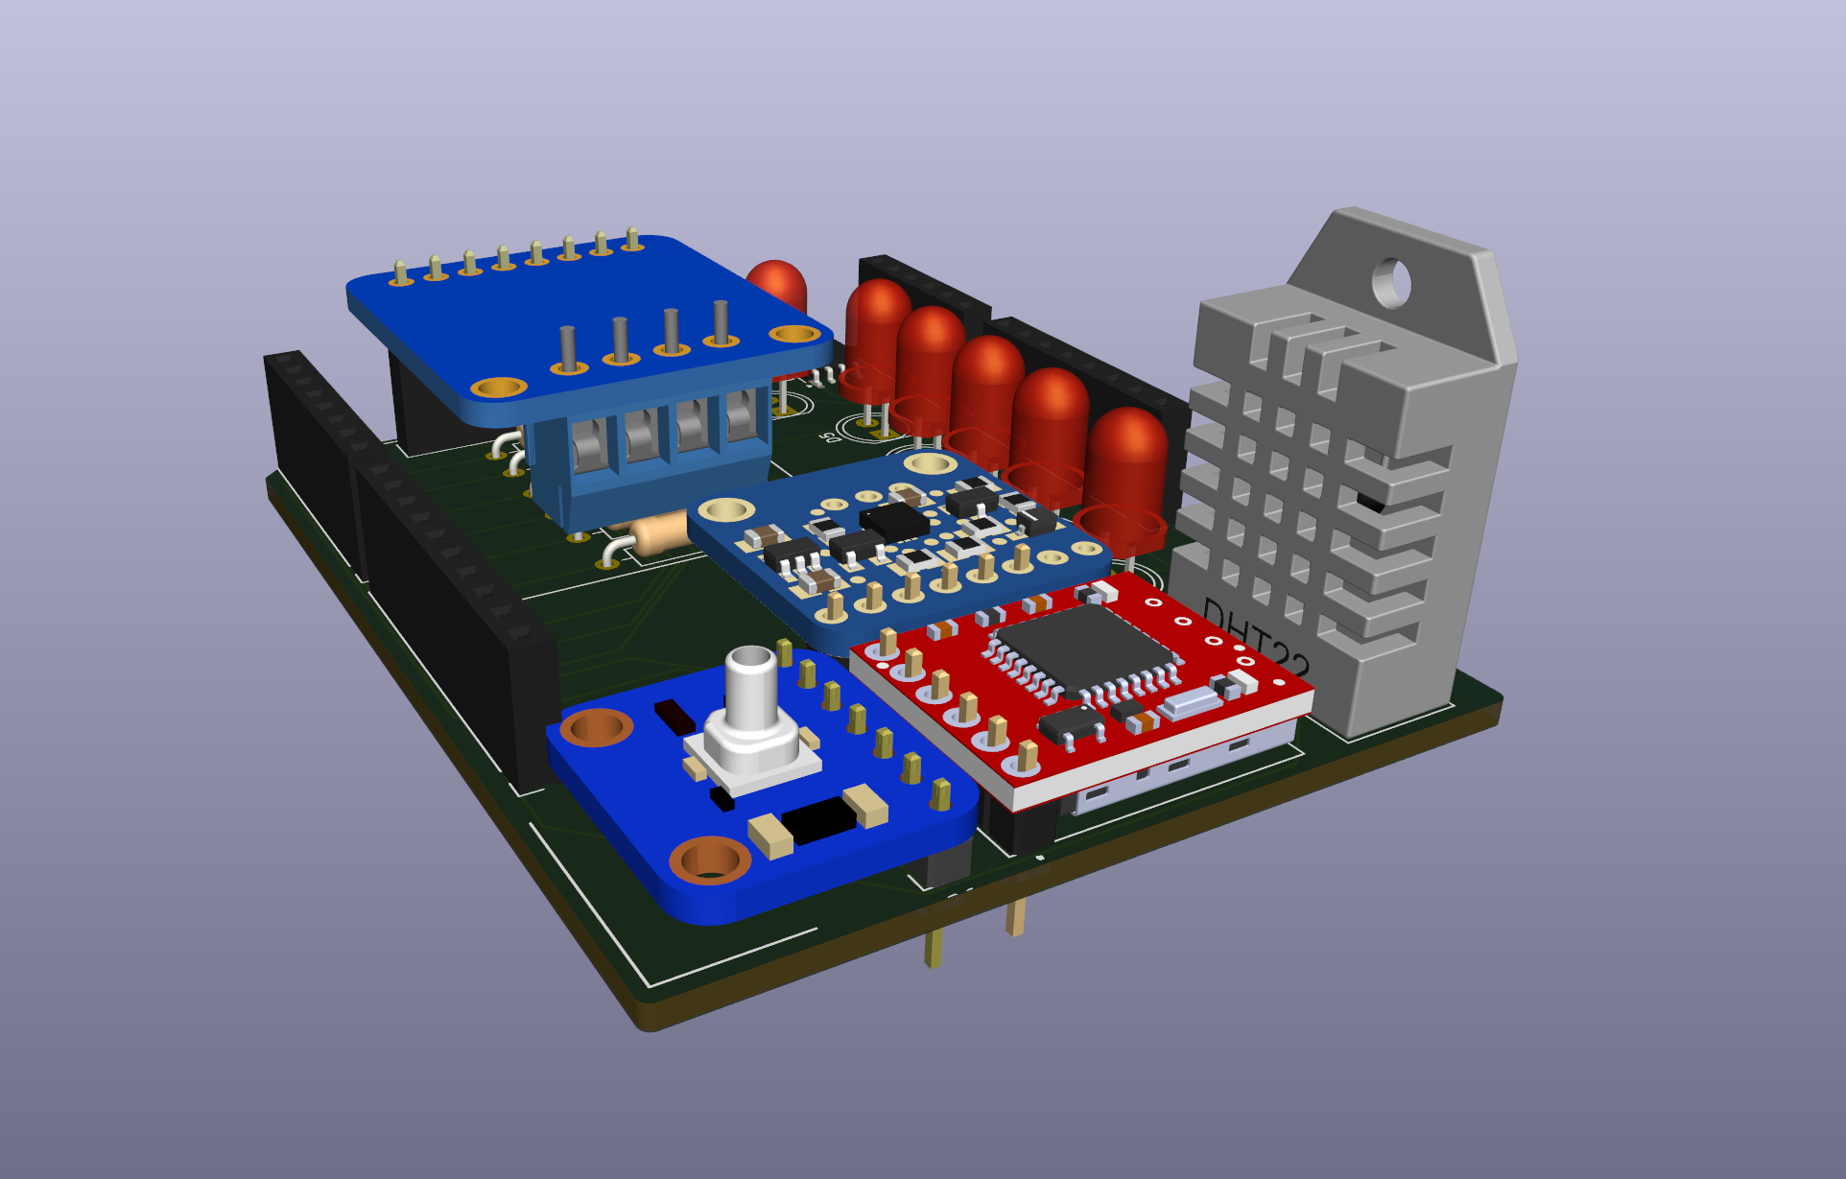
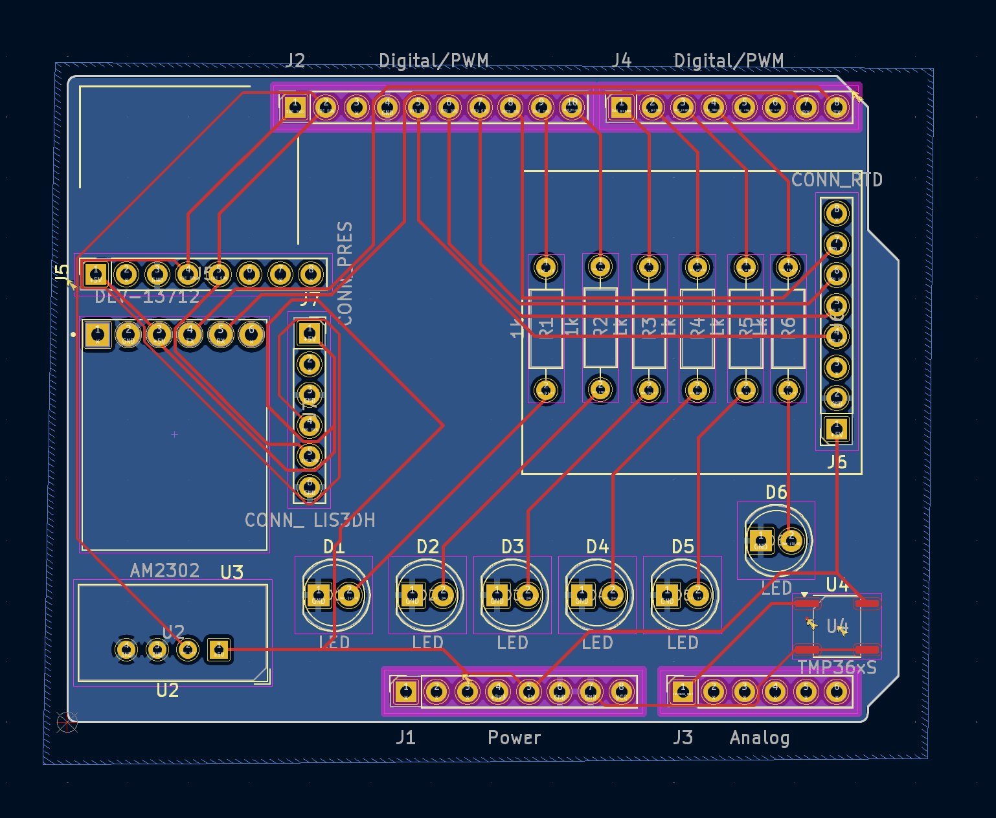
PCB

Slide 13
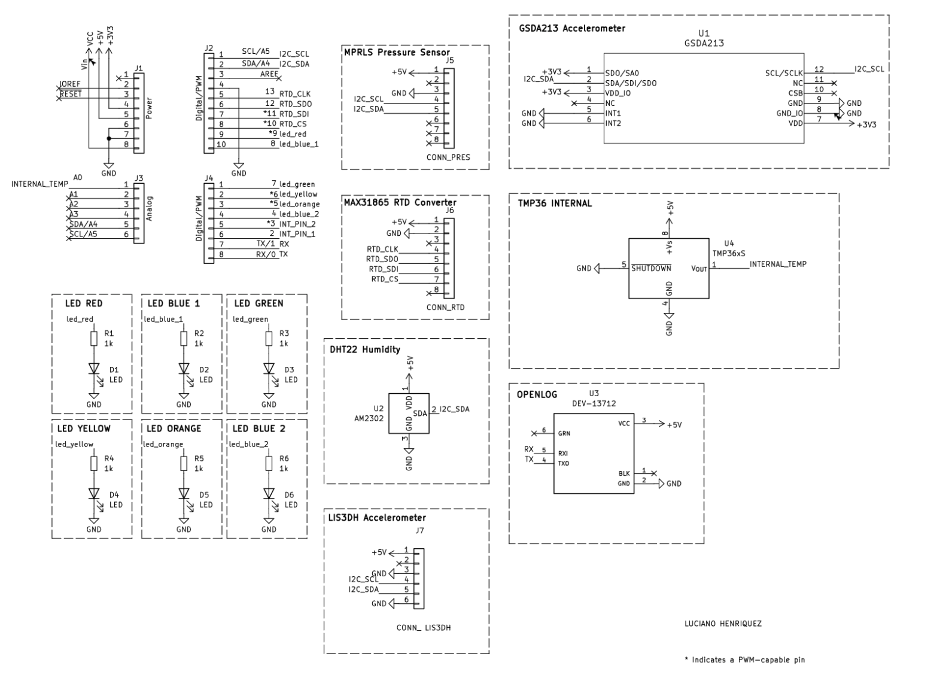
Schematic

